Slide 1
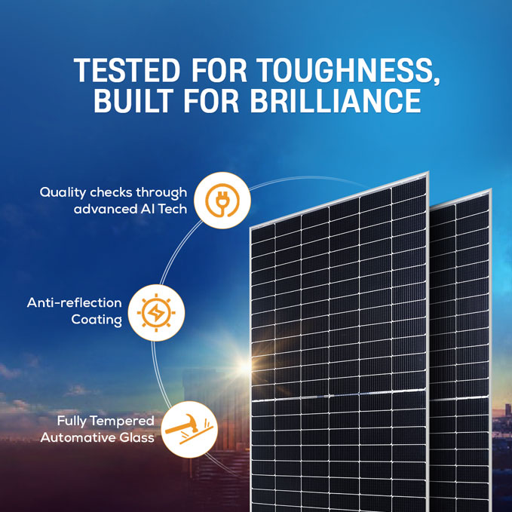
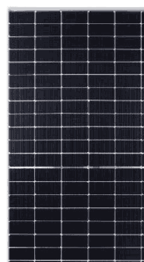
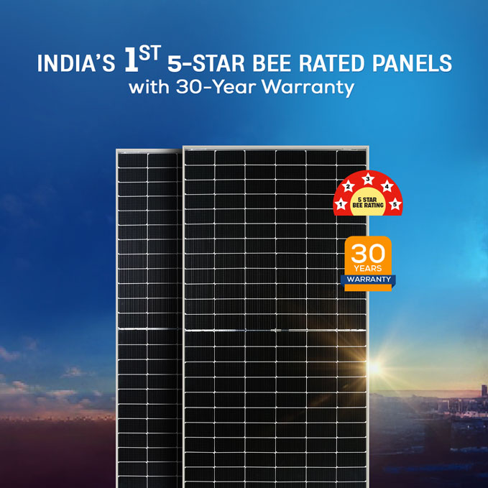
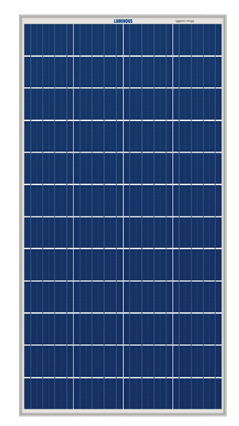
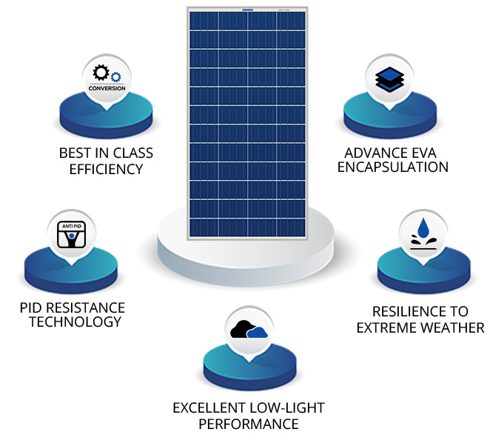
1
LUM 24590TG144 BI-TS
LUMINOUS 590WP TOPCON PANEL
Excellent Power Generation under Low LighT.
Anti reflection coating
COST : Rs. 11000/- , MRP- Rs. 21200
2
LUM 12170P-Polycrystalline Panel
COST : Rs. 4400/- , MRP- Rs. 6500

Slide 2
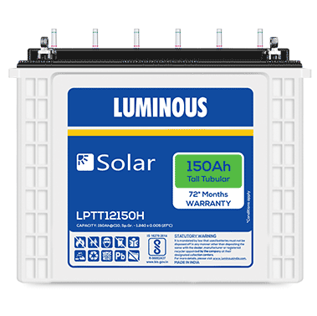
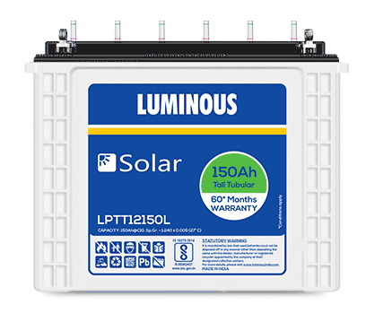
Solar Battery 150AH- LPTT12150H
(72 Months Warranty)
3
COST : Rs. 12854 + GST/- , MRP-Rs.23600
4
Solar Battery 150AH-LPTT12150L
(60 Months Warranty)​
COST : Rs. 11952 + GST/- , MRP-Rs.21400
Common for both Battery
Luminous Solar Batteries are C10 rated deep cycle batteries specially designed for longer back up.
Very Low Maintenance
Topping up frequency : Once in 8 to 10 months
Long Design Life Long cycles (1500@80% DOD, 5000 @20% DOD)
High Temperature Performance
Can handle extreme weather conditions

Slide 3
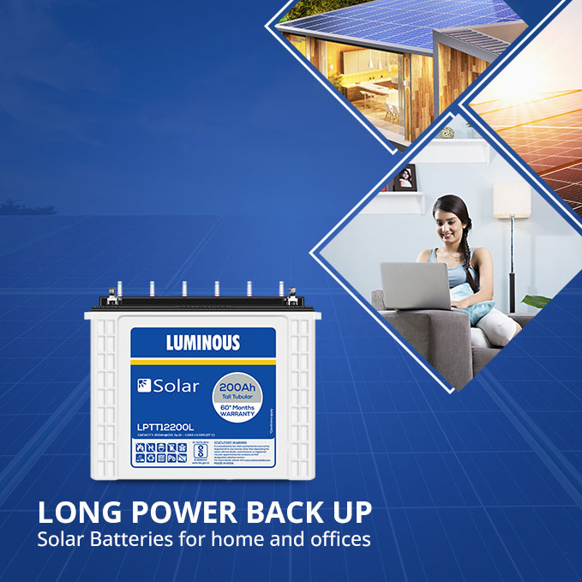
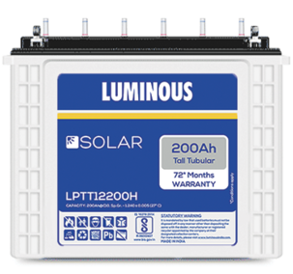
Solar Battery 200AH- LPTT1200L
(60 Months Warranty)
5
COST : Rs. 15900 + GST/- ,
MRP-Rs.25900
6
Solar Battery 200AH-LPTT12200H
(72 Months Warranty)​
COST : Rs. 16682 + GST/- ,
MRP-Rs.27200
Common for both Battery
200 Ah Rated Capacity @ C10, 12V,
Longer life without discharge with self-discharge rate of 3% per month STC.
Low maintenance with a topping frequency of 8-10 months, low maintenance with level indicators.
Efficient battery with Higher AH efficiency > 90%, and WH efficiency > 80%.
Long Design Life Long cycles (1500@80% DOD, 5000 @20% DOD)
Corrosion resistance and High temp performance
Designed with thicker positive plates and 20% more electrolyte to withstand power outage.

